Slide 1
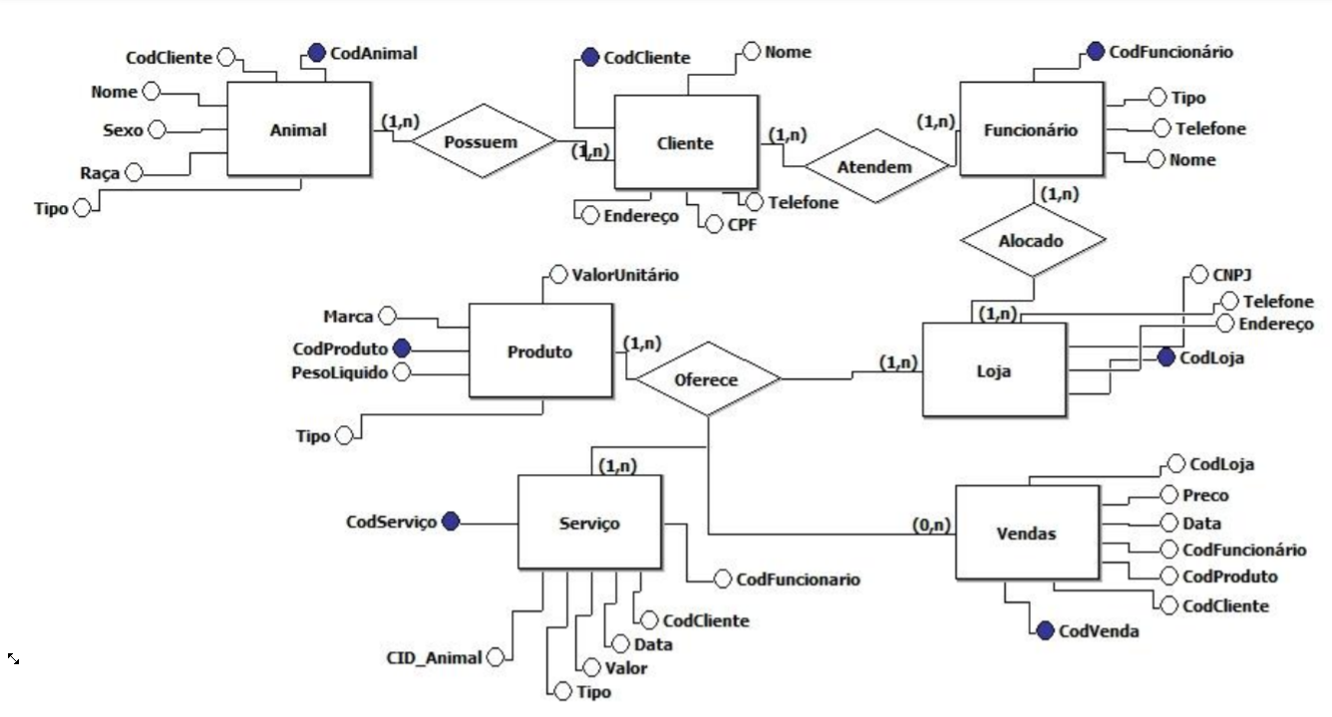
Petshop - Diagrama

